Slide 1



AI-POWERERED
SKILLMATCHER & SKILL RECOMMENDATION SYSTEM
By –
Arudra Vihar Bommana
Purojita Singh
Aditya Samal
Harsh Kumar
Deekshith M

Slide 2

PROBLEM STATEMENT
Difficulty for candidates to understand skill gaps in job applications
Recruiters spend time manually comparing resumes to job descriptions
Lack of intelligent recommendations for alternate job fits
SOLUTION OVERVIEW
SkillMatcher automates skill extraction and comparison
Highlights matches, weak areas, and missing skills
Recommends suitable job roles based on resume alone
Keeps historical data for tracking growth and applications

Slide 3
CORE FEATURES
SkillMatcher automates skill extraction and comparison
Custom AI & NLP-Powered Skill Extraction
Intelligent Skill Comparison & Gap Analysis
Highlights matches, weak areas, and missing skills
Recommends suitable job roles based on resume alone
Keeps historical data for tracking growth and applications

Slide 4
SYSTEM ARCHITECTURE
[USER UPLOADS RESUME & JOB DESCRIPTION]
│
▼
CLIENT PREPROCESSING (PARSE PDF/TEXT)
│
▼
SUPABASE EDGE FUNCTIONS INVOCATION
(ANALYZE-RESUME / RECOMMEND-JOB)
│
▼
SKILL EXTRACTION & COMPARISON LOGIC
│
▼
JSON RESPONSE → BROWSER STORAGE
│
▼
REACT UI RENDERING
(RESULTSDISPLAY → HISTORY → JOBSUGGESTIONS)

Slide 5



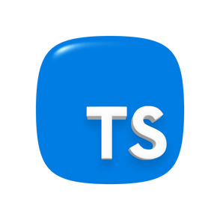
TECHNICAL ARCHITECTURE
Frontend: React + TypeScript + Tailwind + shadcn/ui
Backend: Supabase Edge Functions (Deno)
Core Modules:
CustomSkillExtractor
CustomJobMatcher
generateRecommendations
scoreJobFit
Tools: string-similarity-js, ESLint, React Query

Slide 6
FUTURE ENHANCEMENTS
OAuth Authentication & Cloud Sync
Admin Analytics Dashboard
Custom Skill Database per Organization
Exportable Reports (PDF/CSV)
KEY TAKEWAYS
Bridges the gap between resumes and job requirements
Empowers candidates with actionable insights
Scalable architecture ready for enterprise integration

